Slide 1
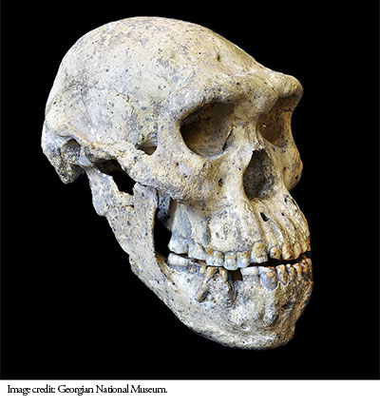
Human Ancestors

Slide 2
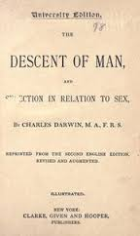
Charles Darwin – The Descent of Man
In 1871 Charles Darwin published the book ‘The Descent of Man’
He proposed that because humans and apes have many structural similarities then they may share a common ancestor.
This claim by Darwin sparked many scientists into wanting to investigate his claims. This was due to the fact that at the time the claims were made there was very little fossil evidence to support them.

Slide 3
Task:
Using the information available in your textbook (pg 287-288), construct a timeline of the research conducted between the publication of Darwin’s book in 1871 and 1893.
Your timeline should include information such as significant researchers, discoveries made, locations of discoveries etc.
Questions?
You have got 20 minutes – go!

Slide 4
Effect of the environment on hominin evolution
From previous chapters we know that evolution occurred as a result of environmental pressures.
Greater reliance on bipedal locomotion due to the shift from near continuous forest to wooded savannah/grassland, approx 5-6 million years ago.
Many arboreal species struggled to survive in this new environment – why?
What are reasons why these species evolved?

Slide 5
Australopithecines
The first Australopithecine fossil was found in a limestone quarry not far from the town of Tuang in the North West province of South Africa.
The fossil scull was sent to Australian anatomist Raymond Dart who upon deep analysis concluded that the fossil did not belong to any ape group (although it did show strong resemblance to juvenile gorilla skull)

Slide 6
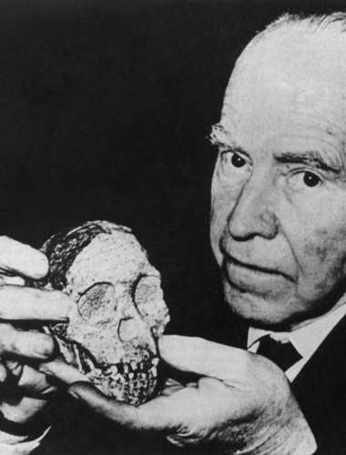
Australopithecines
The species was believed to have existed around 2.5 million years ago.
Dart named it Australopithecus Africanus (the southern ape of Africa)
It was believed to be a midpoint between ape and man
Dart published an article ‘Nature’ which presented his finding, though it was met with scepticism.

Slide 7
Australopithecines
Many other fossil remains have been discovered throughout South Eastern Africa which have contributed to the Australopithecine fossil records.
These include:
Paranthropus robustus – skull discovered in South African cave (believed to be approx. 2.7 million years old)
Australopithecus afarensis (Lucy) – 40% skeletal remains discovered in Hadar (believed to be 3- 3.6 million years old)
23 metre long trail of footprints – found in volcanic ash in Laetoli, believed to be that of 3 hominids. Potassium-argon dating and stratigraphy placed footprints approx 3.56 million years ago. Believed to be Australopithecus afarensis.

Slide 8
Lucy
http://www.bbc.com/earth/story/20141127-lucy-fossil-revealed-our-origins

Slide 9
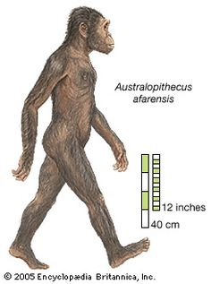
Australopithecus afarensis

Slide 10
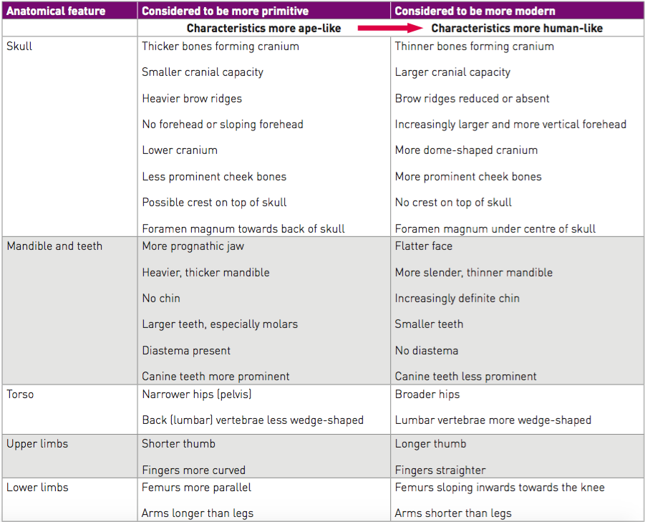
Anatomical features of Australopithecus

Slide 11
Variation within Australopithecines
Paranthropus robustus and Australopithecus afarensis are both very similar species of Australopithecines, however there are some key anatomical differences.
Fossil remains of Australopithecines have shown two main variations – a gracile (slender) body shape and a more robust (heavier) body shape.
Paranthropus robustus is an example of a robust form.
Australopithecus afarensis is an example of a gracile form.

Slide 12
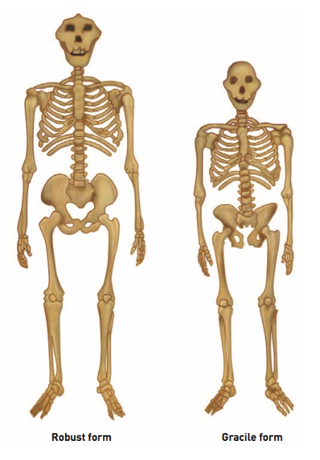
On the diagram label the major anatomical differences between a robust and gracile Austrlopithecine. Give a species name to each of the skeletons

Slide 13
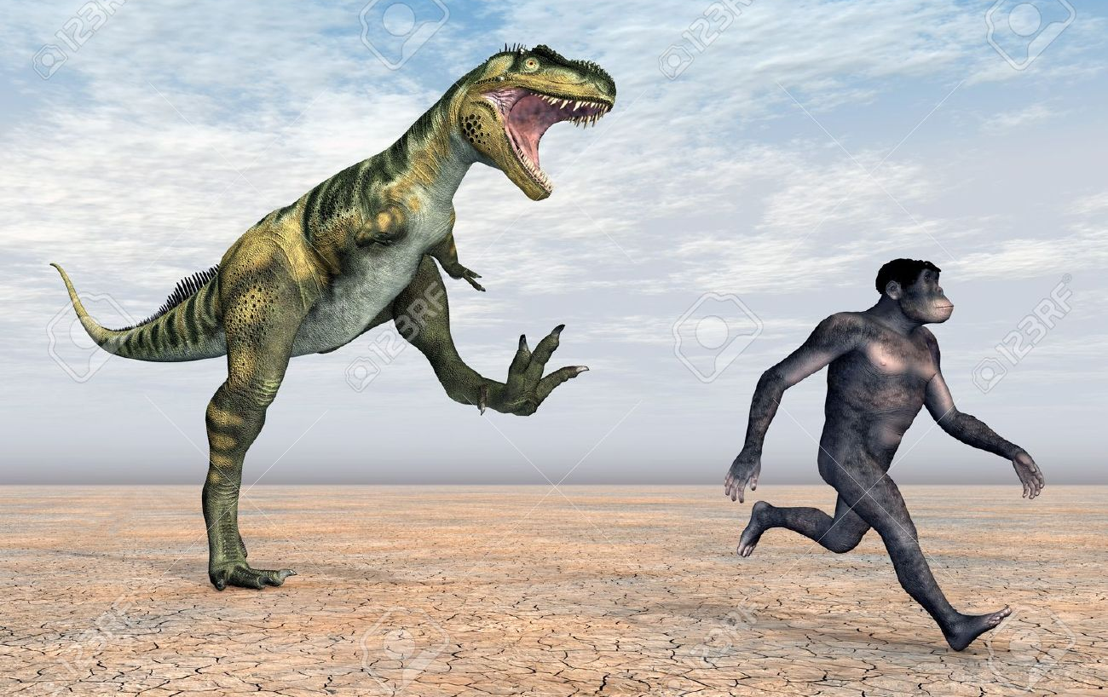
Selection pressure for bipedalism?

Slide 14
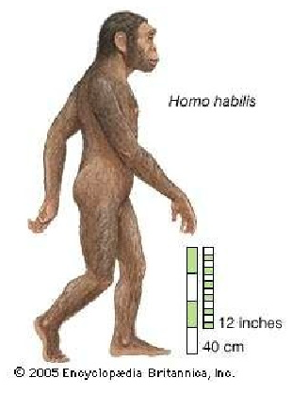
Homo habilis
Homo habilis (handy man)
First discovered in Olduvai Gorge (again in Eastern Africa) by Dr Louis Leakey, Prof Phillip Tobias and Dr John Napier.
Believed to have lived approx 1.6-1.9 million years ago.
http://hoopermuseum.earthsci.carleton.ca/emily/eighth.html

Slide 15
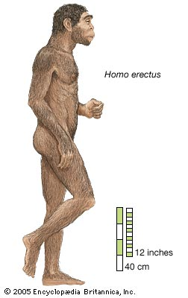
Homo erectus
Homo erectus (upright man)
First discovered near Java (Indonesia) by Eugene Dubois.
Believed to have lived approx 1.4m – 300,000 years ago.
Many fossil discoveries have been made across Africa, Asia and Europe, although it is believed to have originated in Africa.
http://hoopermuseum.earthsci.carleton.ca/emily/nineth.html

Slide 16
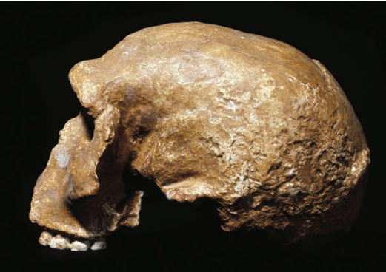
Transition to modern humans
Skull found in 1933 in Steinheim (Germany) which was not fully representative of Homo erectus or Homo sapiens.
Therefore believe to be a species within the transition phase between the two.
Large cranial capacity and similar contours to Homo sapiens, as well as a more prominent forehead than that of Homo erectus.
Estimated age of 250,000 – 350,000 years old

Slide 17
Transition to modern humans cont.
1 million year old cranium discovered Eritrea (East Africa) between 1995 and 1997. Again, believed to be a transition between Homo erectus and Homo sapiens.
European hominids of this form have been named Homo heidelbergensis, named after a mandible was discovered near Heidelberg (Germany) in 1907.
Believed to be common ancestor of both modern humans in Africa as well as Neanderthals in Europe.

Slide 18
Transition to modern humans cont.
A different theory…..
6 individual fossils found in Gran Dolina (Spain) dated to approximated 780,000 years ago.
Thought to be representative of a different species, Homo antecessor.
Some scientists believe this species evolved into:
Homo heidelbergensis and then Neanderthals in Europe
Homo sapiens in Africa

Slide 19
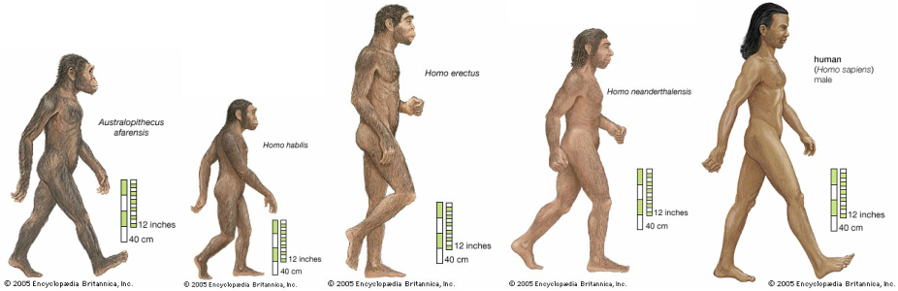
Neanderthals
First fossils discovered in 1856 in a cave in the Neander Valley (Germany)
Suggested as being only a side branch on the pathway to modern humans. This was confirmed using comparative DNA to determine it was it’s own species – Homo neanderthalensis.
Evidence suggests that Homo sapiens and Homo neanderthaensis lived within the same time period in Europe.

Slide 20
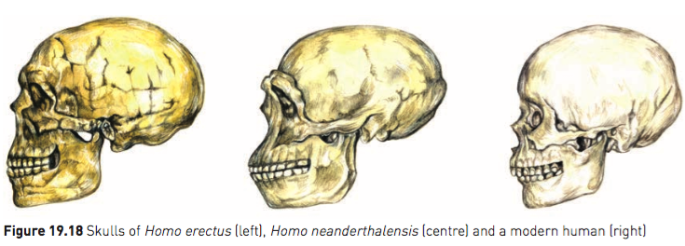
Neanderthals
Characteristics of Homo neanderthalensis include:
Low but large skull
Prominent brow ridges
Large brain (larger than humans)
Drawn out back of skull
Lack of definite chin
Swept back cheekbones
Some prognathism

Slide 21
Modern humans
Fossils discovered near Les Eyzies (France) under an overhanging cliff.
Referred to as Cro-Magnon people.
Cro -hole or cavity
Magnon – Name of the owner of the land
Classed as Homo sapiens due to features such as large cranium with reduced brow ridges, smaller jaw with less prognathism, smaller teeth and a developed chin. Fossils have been date from 40,000 to 10,00 years ago.

